Slide 1

Digital Dashboard Accessibility Module
Office of Government-wide Policy
Presenter: TBD | Date TBD
Notes:
INSTRUCTIONS: Launch Adobe Connect at least 30 minutes before the start of the webinar to make sure there are no technical issues.
Conduct a sound/technical issues check.
Ask participants to confirm whether they can hear you by replying through the Chat pod.
Tell participants to use the Chat pod to report any technical issues they experience during the webinar.
SPEAKER: Welcome to the Digital Dashboard Accessibility Module Webinar. I am XXXX, and I will be your host for today’s session.

Slide 2
Webinar Goal

Slide 3
GOAL: To provide an overview of the purpose, uses, and function of the Digital Dashboard Accessibility module.
Notes:
SPEAKER: During this webinar we will explore the Digital Dashboard’s Accessibility Module. You will get an overview of the module’s purpose, interface and key features, and the benefits you gain from using it as a measure of your agency’s Section 508 conformance. This Webinar will last for approximately 60 minutes.

Slide 4
Webinar Logistics

Slide 5
Webinar Logistics
Technical Support:
Report technical issues via the Chat tool.
Adobe Connect Technical Support
Adobe Connect Visual Quick Start Guide for Participants
Tutorials: https://forums.adobe.com/docs/DOC-6942#jive_content_id_Connect_Tutorials
Adobe Connect Overview
Notes:
SPEAKER: We are now going to take a moment to get familiar with the basic functions of Adobe Connect. Point out the following interface features:
Attendees Pod – This pod lists attendees by role. A microphone icon to the right of the attendee’s name indicates who is speaking. To start a private chat, hover over an attendee’s name.
Chat Pod – Use this pod to send a message to everyone or an individual. Initially, you will only notice a chat labeled “Everyone.” As you add additional chats, they will appear to the right of the “Everyone” chat.
SPEAKER: If you experience any technical issues during the session, please report it through the Chat pod. Or call Adobe Connect Support at 866-229-3239 get help to resolve issues with the software. For more information about using the software, refer to the Adobe Connect Visual Quick Start Guide for Participants or visit https://forums.adobe.com/docs/DOC-6942#jive_content_id_Connect_Tutorials.
NOTE TO MODERATOR: Copy and paste the Adobe Connect technical support number and tutorial Web site in the Chat pod.

Slide 6
Webinar Etiquette
Participate
Mute your phone when you are not speaking
Do not put your phone on hold
Raise your hand to ask a question
Identify yourself when speaking
Notes:
SPEAKER: We encourage you to participate, ask questions and share your experiences. Please keep your phones on mute when you are not speaking.
[Provide instructions on how to mute the phone via the conference line.]
Do not put your phones on hold at any time during the webinar. If you have to take another call or a break, hang up and call back to rejoin.
Some of you may be in a setting where you cannot speak aloud, such as in a cubicle, but we still encourage you to participate through the Chat pod.
When I say “raise your hand,” I mean for you to raise your hand in Adobe Connect by selecting the Hand Raise icon.

Slide 7
Agenda

Slide 8
Today’s Agenda
Introduction
Webinar Objectives
Accessibility Module Purpose and Benefits
Accessibility Module Audience
Accessibility Module Limitations
Using the Accessibility Module
Webinar Wrap Up
Notes:
INSTRUCTIONS: Review the webinar agenda by reviewing the items on the slide.
SPEAKER: After introductions and a review of the Webinar objectives, we will discuss:
Accessibility Module Purpose and Benefits
Accessibility Module Audience
Accessibility Module Limitations
Using the Accessibility Module
The session will wrap up with us sharing the key takeaways we got from the session.

Slide 9
Introductions

Slide 10
Participant Introductions
Share your:
Name
Title/Job Description
Agency
Webinar Expectations
Notes:
INSTRUCTION: Share this information about yourself: The agency for which you work, your job title, a brief description of your responsibilities with regards to procurement and acquisition. Provide your contact information in the Chat pod.
SPEAKER: Let’s take a few minutes to get to know each other. I am XXX…
Please share your name, title/job description, and agency, along with your expectations for the Webinar.

Slide 11
Webinar Objectives

Slide 12
Objectives
Describe the purpose of the Accessibility module of the Digital Dashboard.
Describe the benefits of using the Accessibility module to help monitor your agency’s website Section 508 conformance.
Describe who is eligible to, and how to gain access to the Accessibility module.
Describe the limitations of the information provided through the Accessibility module.
Notes:
INSTRUCTIONS: Review the webinar objectives by reviewing the bullets on the slide.
SPEAKER: Let’s review the main objectives for this Webinar. At the end of this session, you should be able to:
Describe the purpose of the Accessibility module of the Digital Dashboard.
Describe the benefits of using the Accessibility module to help monitor your agency’s website Section 508 conformance.
Describe who is eligible to, and how to gain access to the Accessibility module.
Describe the limitations of the information provided through the Accessibility module.

Slide 13
Objectives, continued
Describe how agency websites are scanned for conformance errors, including frequency and types of errors.
Identify the ways that data can be parsed and/or sorted.
Identify the report export capabilities of the Accessibility module.
Notes:
INSTRUCTIONS: Review the webinar objectives by reviewing the bullets on the slide.
SPEAKER:
Describe how agency websites are scanned for conformance errors, including frequency and types of errors.
Identify the ways that data can be parsed and/or sorted.
Identify the report export capabilities of the Accessibility module.

Slide 14
Accessibility Module Purpose and Benefits

Slide 15
POLL: Have you visited the Accessibility Module?
Yes
No
Notes:
INSTRUCTIONS: Add a Poll with the question on the slide and Yes & No as options. Display the results of the poll question, then ask if any users are willing to share how they used the information.
SPEAKER: Before we begin, I’d like to know how many of you have visited the Accessibility Module. Please answer the poll question in the Chat pod (NEED TO VERIFY THIS IS WHERE A POLL QUESTION DISPLAYS).

Slide 16
Accessibility Module
Purpose
Perform a bi-weekly check of nearly 800 websites to identify three accessibility issues.
Provide a means for government-wide measurement of adherence to the Standards.
Provide feedback to agencies on the items that are tested.
Notes:
SPEAKER: The Accessibility Module works by performing a bi-weekly check of the home page of nearly 800 federal government websites to identify three accessibility issues. This allows us a method to perform a government-wide measure of adherence to the Section 508 Standards.
It also provides an agency means for receiving some feedback on their conformance practices.

Slide 17

Accessibility Module, continued
Benefits
Provides a tool to help monitor agency conformance.
Helps identify issues that can be easily resolved.
Allows you to track and measure performance across component agencies.
Help to identify common patterns and trends in conformance.
Notes:
SPEAKER: So, how can using the Accessibility Module help you and your agency?
First, it provides a tool to help you monitor your agency’s conformance to the Standards. And the issues that are identified by the Module can be easily remedied.
While it won’t perform all of the tests you will need to run, it will give you an easy way to measure and track your performance and compare that against how other component agencies are doing.
And while we cannot fully measure accessibility with automated tools, we can measure for broader issues and help to identify common patterns and trends in conformance.

Slide 18

Why Accessibility Matters
Citizens rely on their government for a range of essential services.
When this information is presented in a way that is not accessible to people with disabilities, those people are shut out from essential services.
Accessibility is the law, and it is everyone’s responsibility.
Notes:
SPEAKER: Why is it important that we ensure our products are accessible?
According to the US Census Bureau, about 56.7 million people — or 19 percent of the US population — had a disability in 2010. That is a huge percentage of the public that we serve. Citizens rely on the government for a range of essential services that impact their well-being, such as medicare/medicaid/social security support, assistance in finding low-income housing, and veteran’s support services from the VA, etc.
When this information is presented in a way that is not accessible to people with disabilities, those people are shut out from essential services and opportunities that should be available to all Americans. Additionally, a large number of Americans with disabilities are employed by the federal government, and having accessible technology is essential for them to be able to perform their work effectively.
And finally, accessibility is the law of the land. All federal employees and contractors who produce ICT products or services for the federal government have a responsibility to make sure persons with disabilities are able to access and use the ICT they develop.

Slide 19
Accessibility Module Audience

Slide 20
Audience
Access is granted to any user with a Max account
Information contained in the Accessibility Module many be useful to:
Section 508 Program Manager and other persons responsible for conformance
Agency Chief Information Officer (or designated representative)
Content manager
Programmer and other member of the technical development team
GSA/OMB for semi annual reports of program maturity
Notes:
INSTRUCTIONS: Access to the Accessibility Module is granted to any federal employee who has a Max account. By default, individuals only have access to agency-wide data, not government-wide access.
The expected audience for the Accessibility Module includes:
Section 508 Program Manager and other persons responsible for conformance
Agency Chief Information Officer (or designated representative)
Content manager
Programmer and other member of the technical development team
GSA/OMB for semi annual reports of program maturity

Slide 21
Accessibility Module Limitations

Slide 22
Limitations
Tool currently scans for only three potential issues, which is a small percentage of compliance criteria.
Tool only scans the home page of each website.
Contrast can only be tested for color assigned programmatically
Graphic text contrast is not tested
Tool won’t uncover errors for empty alt tags or inadequate text descriptions.
Reports must be supplemented by other more robust tools and manual testing.
Notes:
SPEAKER: Because the Accessibility is only scanning the home page and is only measuring three issue types, it will only capture a small percentage of potential issues.
All issues which prevent full access to websites is not possible with the current state of automated testing tools. For instance, while we can automatically check if an image on a website has an alt text attribute, we cannot measure if that alt text is sufficiently descriptive; a picture of a dog with an alt text attribute that reads “cow” would pass the automatic check, but since the alt text is incorrect, the image is not accessible. While we can detect the background color and text color by reading a page’s Cascading Style Sheets (CSS), we may not be able to detect the color of an image; if text is overlayed on a background image, we would not be able to measure whether the level of contrast is sufficient. It is for these reasons that fully assessing a site’s accessibility still requires manual evaluation by an accessibility professional.
While tools like this one can give you a good overview of some of the more important issues, and are certainly a big help in assessing your website’s compliance, no tool can completely replace manually assessing your pages. Using manual review techniques such as navigating your site by keyboard only and with a screen reader are crucial for determining whether or not you have an accessible website. Make sure every part of your site is navigable, and content can be accessed by every user. Even better, collect feedback from users with disabilities. They’ll likely catch things even the best pros won’t.

Slide 23
Using the Accessibility Module

Slide 24
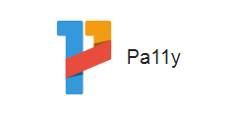
How It Works
Uses open source Pa11y testing engine.
Performs a bi-weekly scan of the home page for all federal government websites
Notes:
SPEAKER:
Pally is an open source tool which scans websites daily. Graphs help you track your performance overtime and compare your performance with others.

Slide 25
Conformance Issues
Bi-weekly spot-check scans identify three types:
Color Contrast
HTML Attributes
Missing Descriptions
Identifies programmed elements where there is not enough color contrast between text and its background.
Conformance requires enough contrast so that text can be read by people with moderately low vision (specifically a contrast ratio of 4.5:1).
Identifies anchor elements with a valid attribute, but where no link content has been supplied.
Identifies anchor element with no link content and no name and/or ID attribute.
Full conformance requires that sufficient information about all user interface components is available to assistive technology.
Identifies images and other non-text content that are missing a text description.
Full conformance requires a meaningful text description. This requires manual inspection.
Notes:
SPEAKER: The Accessibility Module performs a bi-weekly spot check informed by the current Section 508 standards and WCAG 2.0 success criteria associated with each standard.
The tool currently scans the website home pages for three types of issues:
Color contrast: The Module is checking to ensure there is enough contrast between text and its background. Full conformance with 1194.21(d) requires that text can be read by people with moderately low vision (specifically a contrast ratio of 4.5:1).
HTML attributes: The Module is checking for anchor elements found with a valid attribute, but where no link content has been supplied as well as anchor element found with no link content and no name and/or ID attribute. Full conformance with 1194.21 (d) requires that sufficient information about all user interface components (including identity, operation, and state) is available to assistive technology.). Full conformance with 1194.21 (d) requires that sufficient information about all user interface components (including identity, operation, and state) is available to assistive technology
Missing text descriptions: The Module checks to determine if images and other non-text content, including user interface elements, contain a text description. Because the meaningfulness of a description (that is, does the tag describe the image accurately?) cannot be confirmed by the scan, that must be manually inspected.

Slide 26
Expanded Accessibility Checks
The Expanded Accessibility Report provides additional checks, such as:
Forms
Fields have accessible names
Forms contain adequate headings
Elements have names available to an accessibility API
Tables
Buttons are accessible
Elements have a unique ID attribute value
Titles
All pages have titles
Screenreader reads page titles first on every page
Links and Buttons
Buttons have text that describe the destination
Input buttons have discernable text
Anchor elements are not empty
Keyboard Access
Scrollable content for focusable elements enables keyboard navigation
Language
All documents have language attributes
Specified language is valid
Notes:
SPEAKER:
The Expanded Accessibility Report lists the findings of the expanded website scan reported by WCAG Success Criteria categories. The Expanded Accessibility Report runs more than 60 additional website tests. Examples of tests run by the Digital Dashboard Accessibility Module’s Expanded Accessibility Report include:
Forms
Tables
Titles
Links and Buttons
Keyboard Access
Language
Add that full report is available

Slide 27
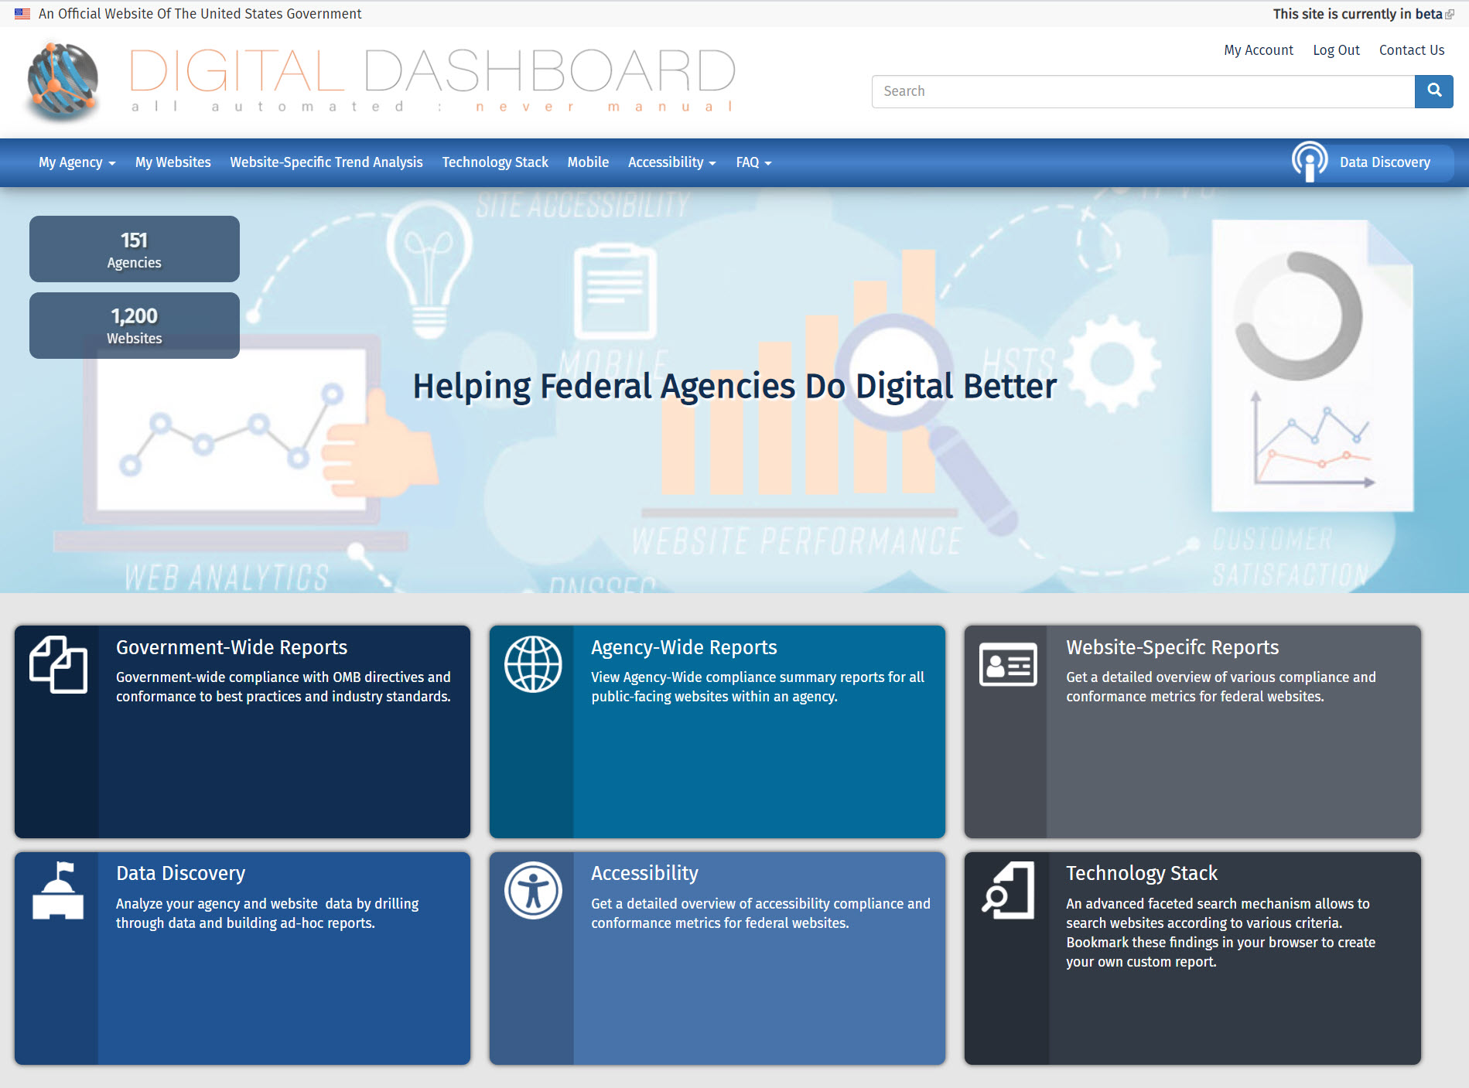
Navigating to the Accessibility Module
https://digitaldashboard.gov/
1. Log in
2. Select Accessibility
Notes:
SPEAKER:
The Accessibility Module can be accessed from the Digital Dashboard: https://digitaldashboard.gov.
Once logged in, select the Accessibility button from the home page of the Digital Dashboard.
NOTE TO MODERATOR: Copy and paste this link in the Chat Tool - https://digitaldashboard.gov

Slide 28
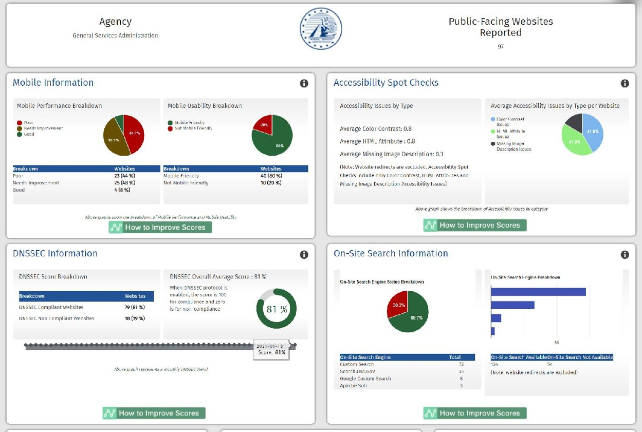
Agency Dashboard
Notes:
SPEAKER: The My Agency tab at the top of the screen displays your agency’s accessibility dashboard, which provides a at-a-glance view of your agency’s performance on all of the issues measured by the dashboard.

Slide 29
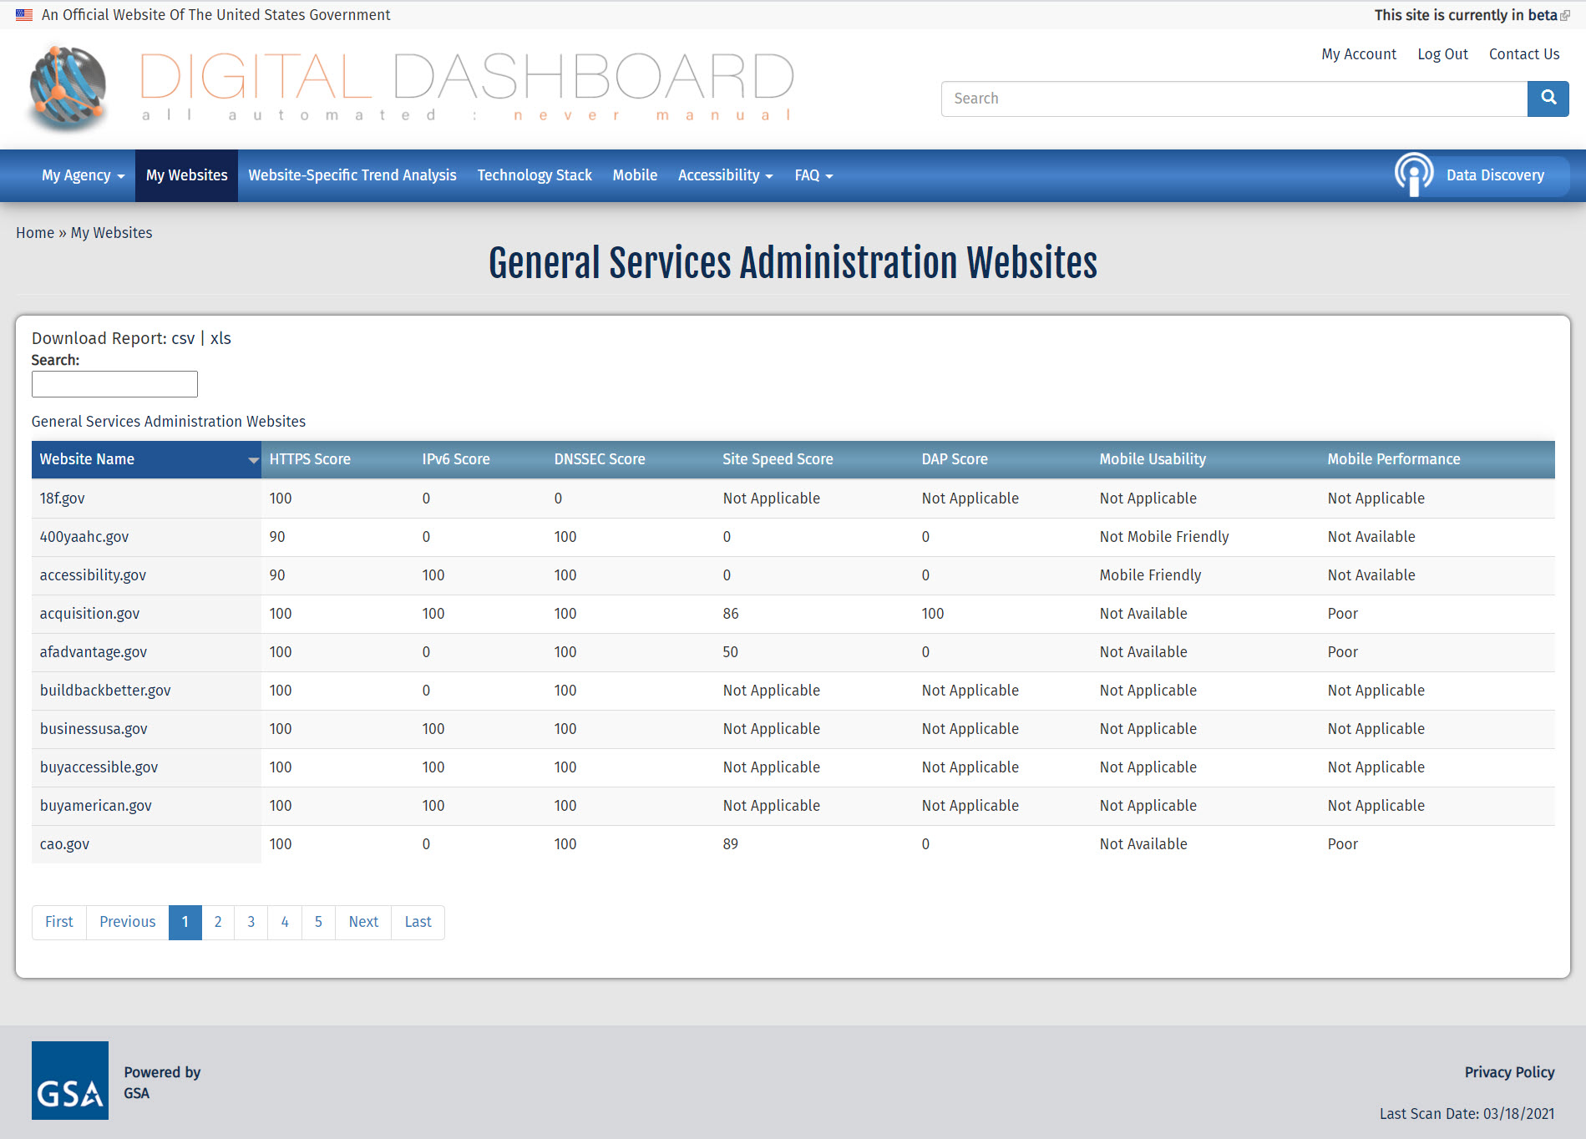
My Websites
Notes:
SPEAKER: Selecting the My Websites tab opens a report of the same measures listed on the dashboard but in a table format listed by agency website.

Slide 30
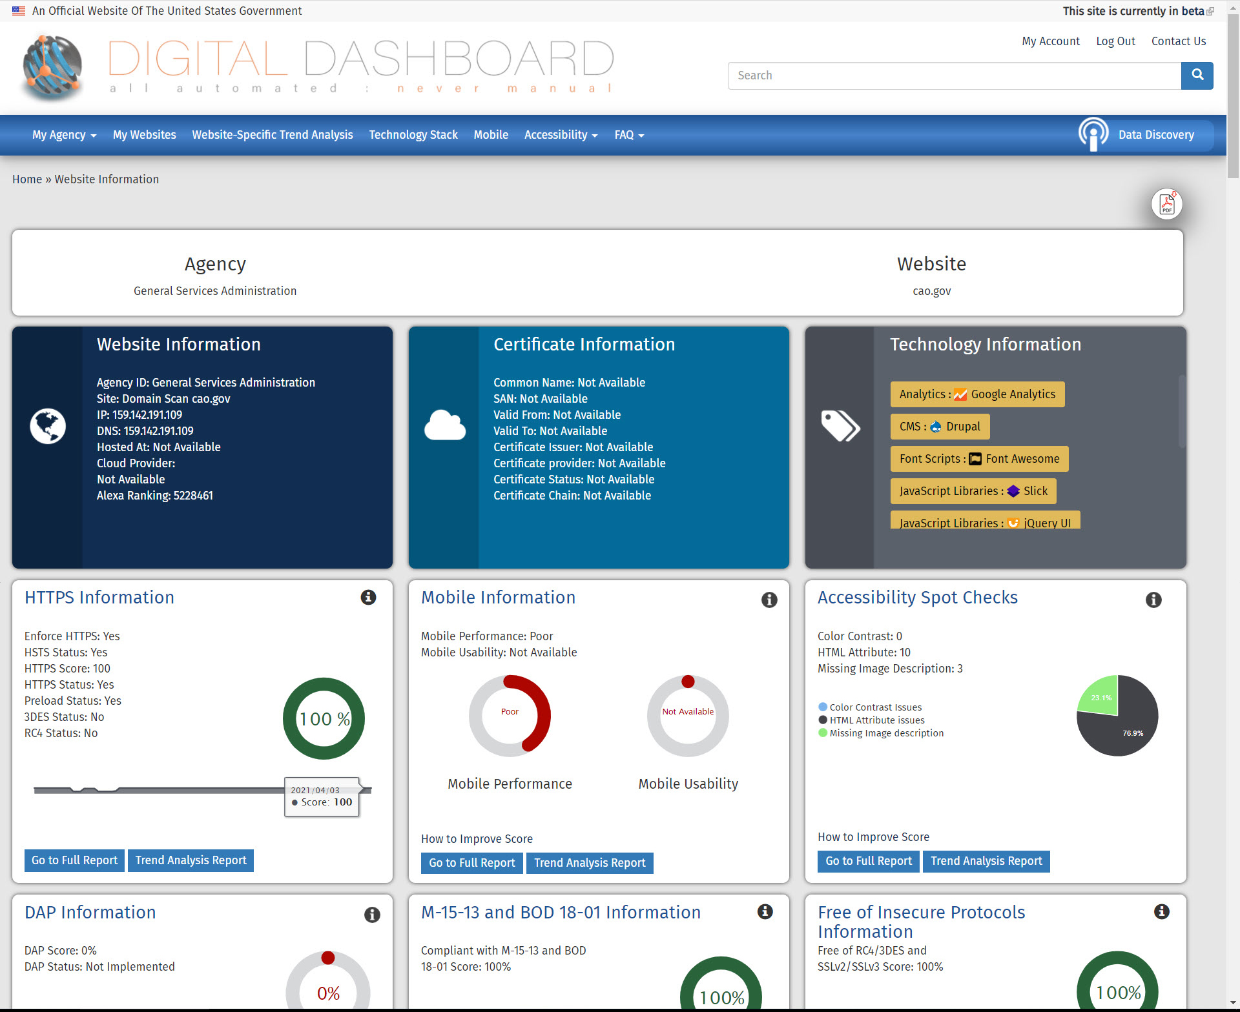
Website Information
Notes:
SPEAKER: Selecting one of the websites in this table opens a dashboard for that website as shown here.

Slide 31
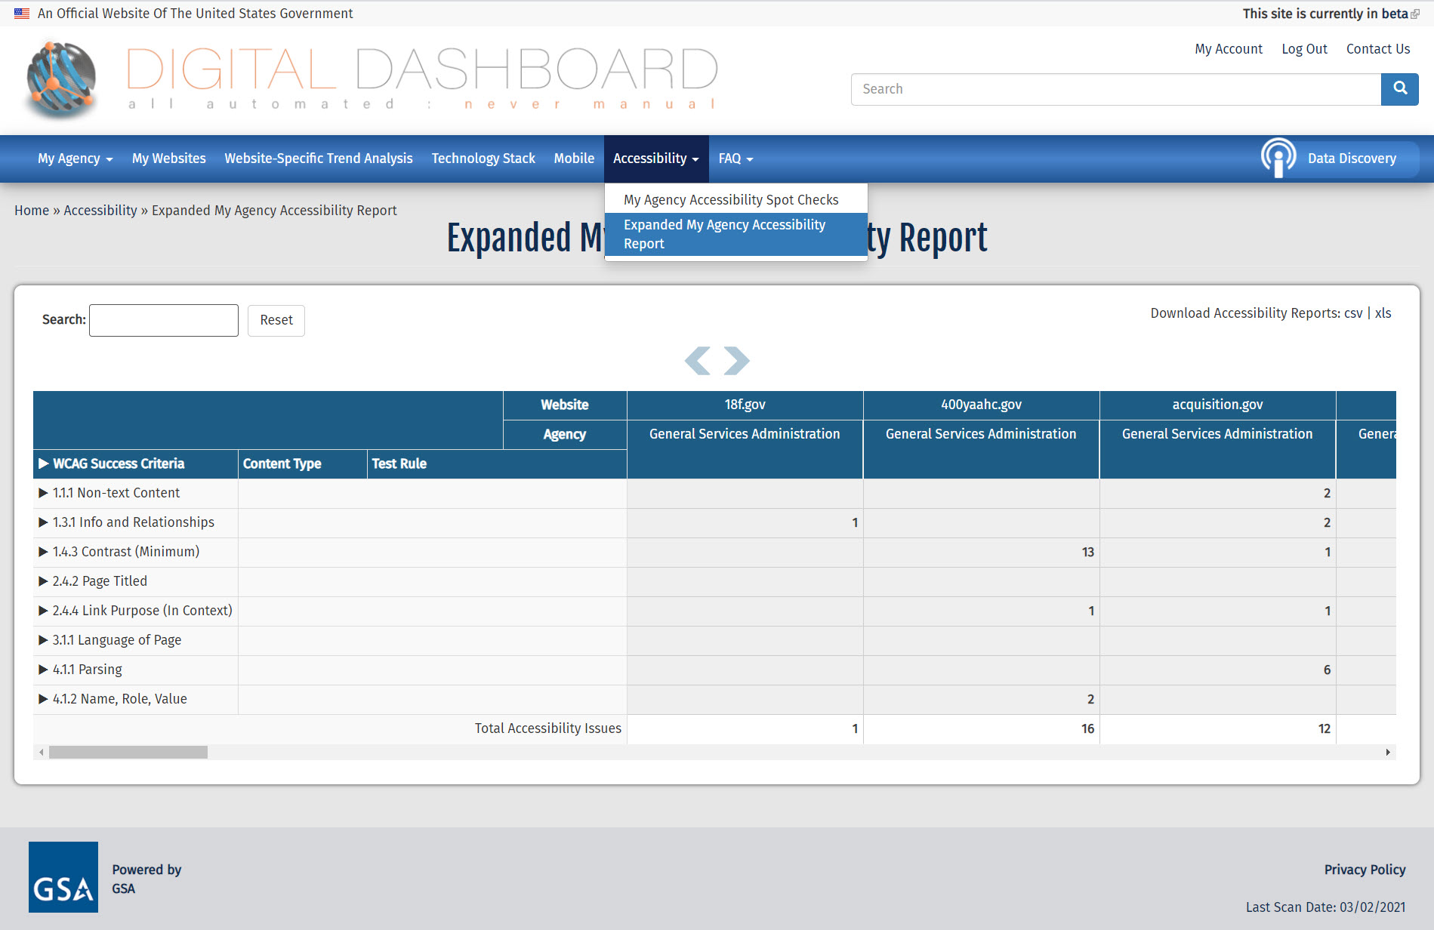
Accessibility Menu
Notes:
SPEAKER: The primary features you will need to review the Digital Dashboard accessibility checks are in the Accessibility Menu. They include the Accessibility Spot Checks and the Expanded Accessibility Report. Let’s look at each of those now.

Slide 32
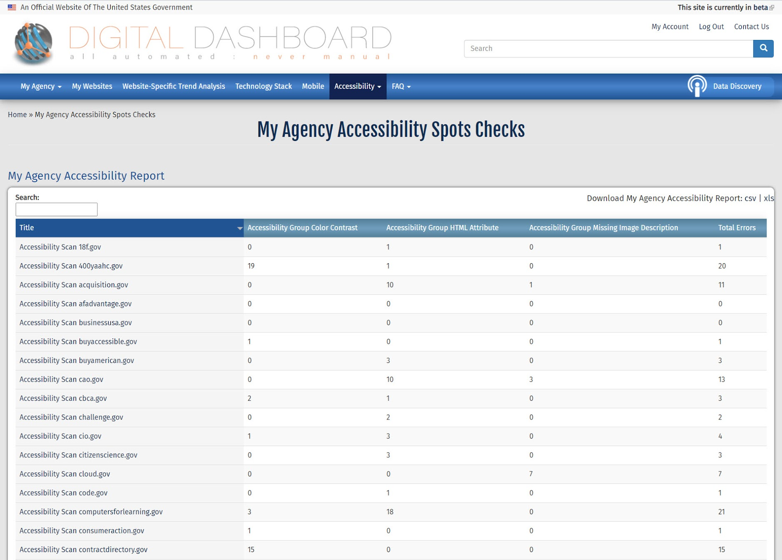
Accessibility Spot Checks
Export data
Sort results by column headings
Search by website name
Notes:
SPEAKER: The My Agency Accessibility Spot Checks report lists the spot check findings for all scanned websites affiliated with your agency. The spot checker looks for color contrast, html attribute, and missing alt tag issues.
This table shows the website name, finding by issue type, and total number of issues for that website.
This table can be sorted by any of the column headings (ascending or descending order) by selecting that column heading and then using the drop down box to indicate how you want to sort it. You can also use the Agency drop down list to view the report for a different agency or use the Search box to search for the results for a particular website.
This information can be downloaded in either a csv or xls format if you’d like to keep it for further reference.

Slide 33
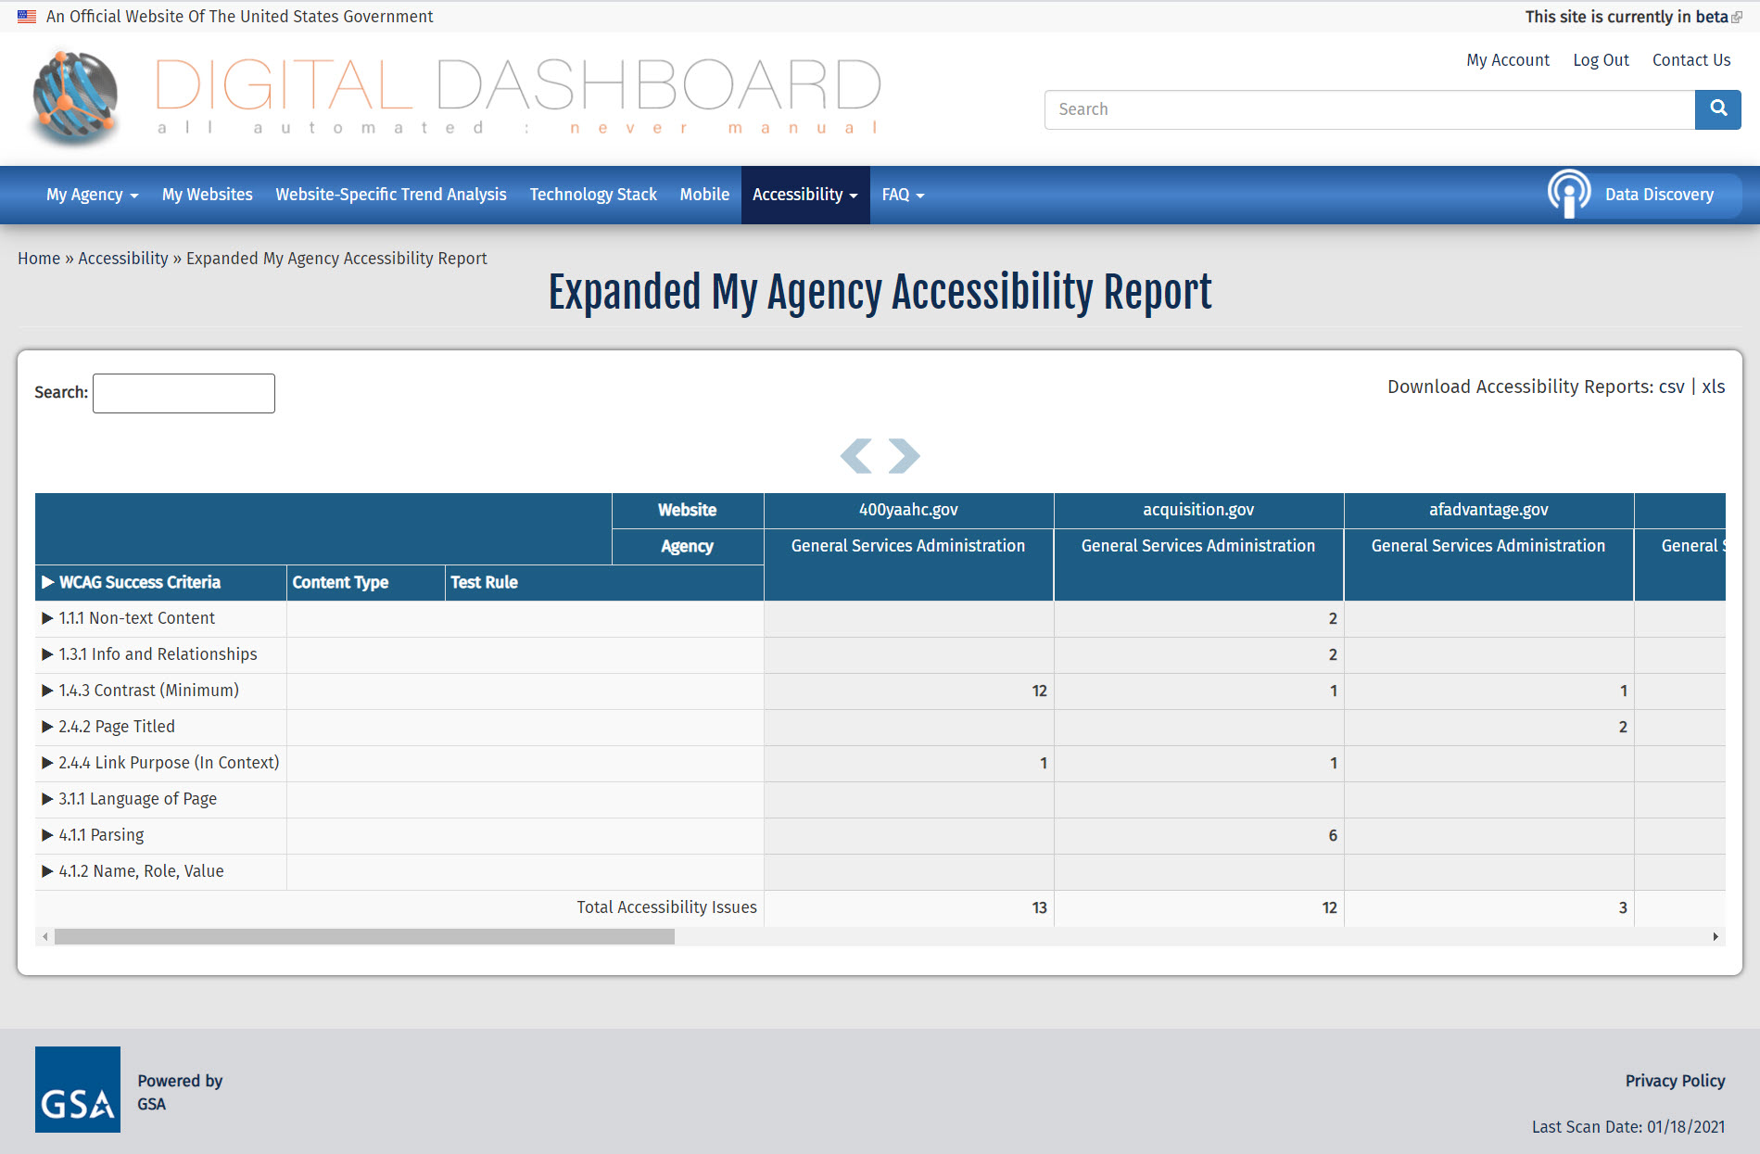
Expanded Accessibility Report
Export data
Scroll through results for your agency’s websites
Search by website name
Notes:
SPEAKER: The My Agency Expanded Accessibility Report lists the findings of the expanded website scan. These are reported by WCAG Success Criteria categories.
This table shows the website name, finding by issue type, and total number of issues for that website.
You can use the arrows above the report to scroll through the various websites at your agency or use the Search box to search for the results for a particular website.
This information can also be downloaded in either a csv or xls format if you’d like to keep it for further reference.

Slide 34
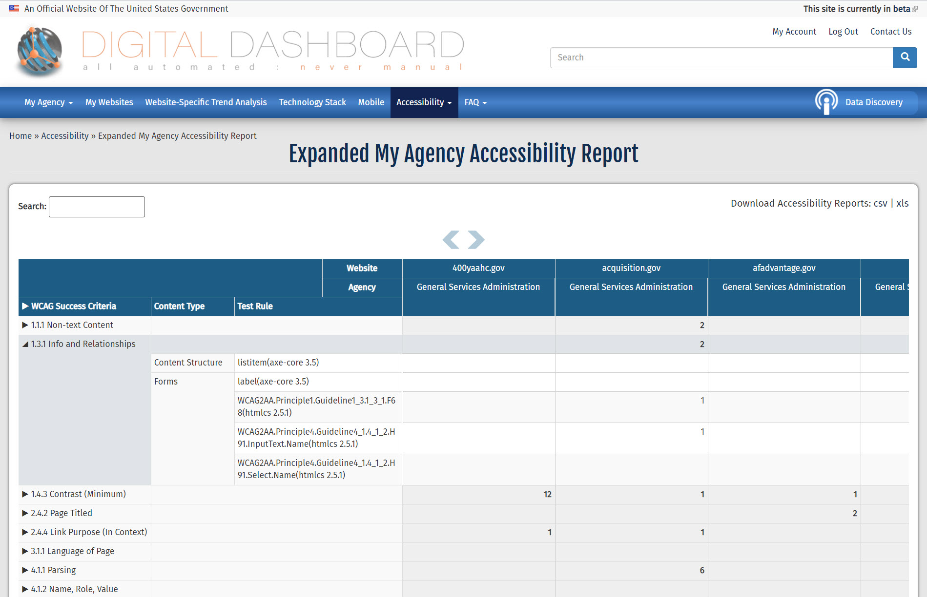
Expanded Accessibility Report, cont.
Select to expand
Notes:
SPEAKER: The WCAG Success Criteria can be expanded to show the content type and test rule for each criterion by selecting the triangle next to the relevant criterion.

Slide 35
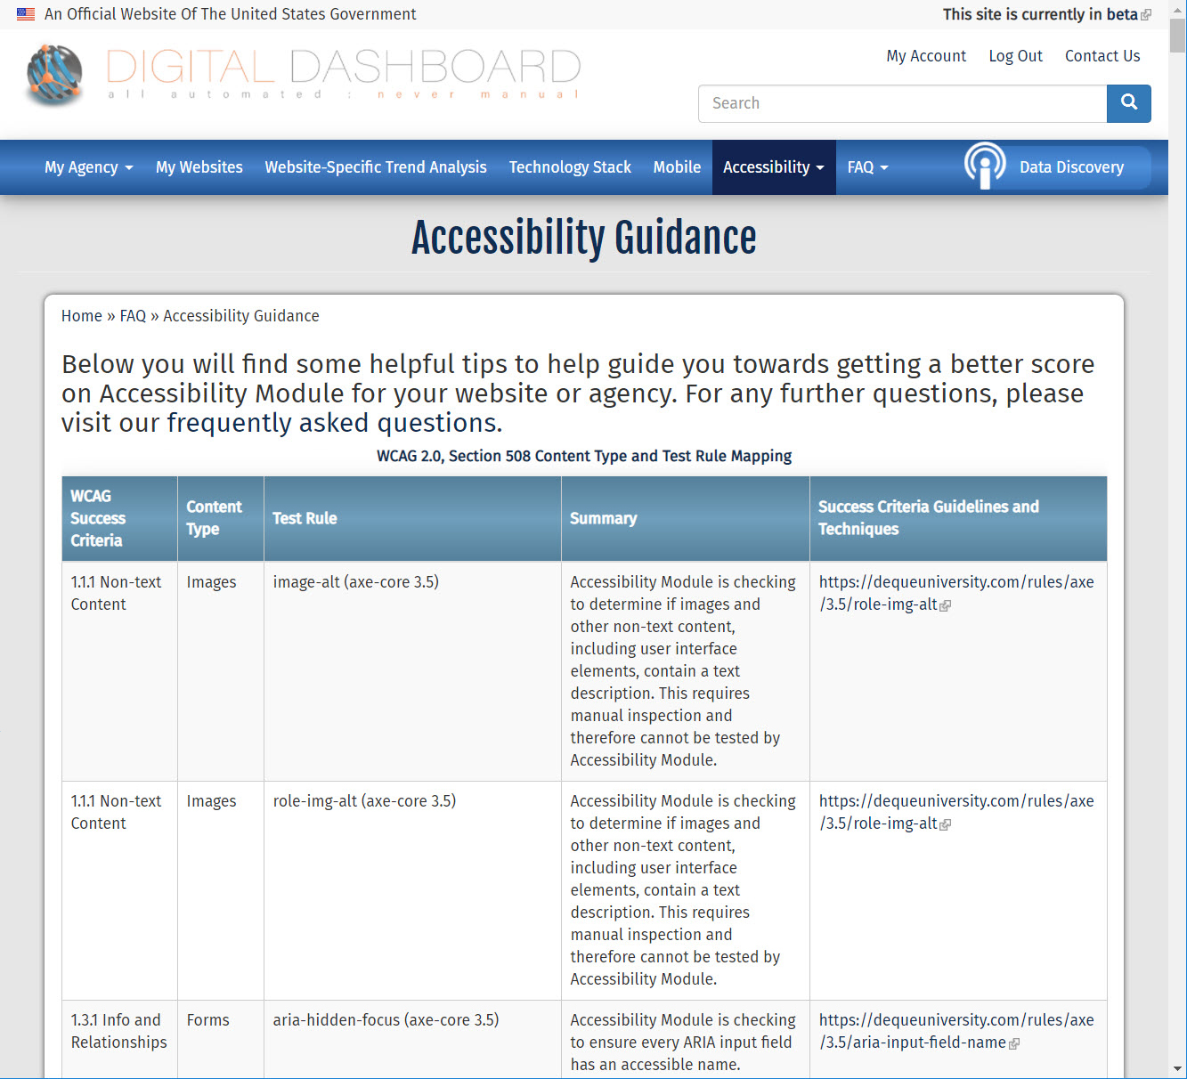
Accessibility Guidance
Notes:
SPEAKER: You may also access the Accessibility Guidance page from the Accessibility tab. The Accessibility Guidance page offers information to help you understand what is being scanned and tips you can use to improve your website’s results. It includes a lot of the information that we have discussed here today.

Slide 36
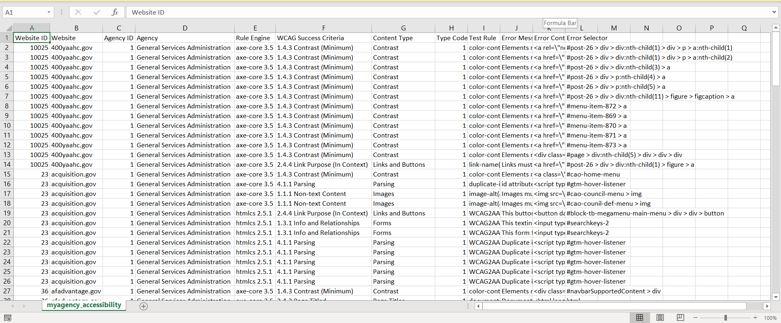
Downloaded Accessibility Report
Notes:
SPEAKER: This is an example of the scan data in a downloaded report. This will list the location or attribute that is creating the issue, a description of the reason for the finding, and a reference to the associated WCAG guideline. This information will help you identify the specific issues on your page so that you can correct them.

Slide 37
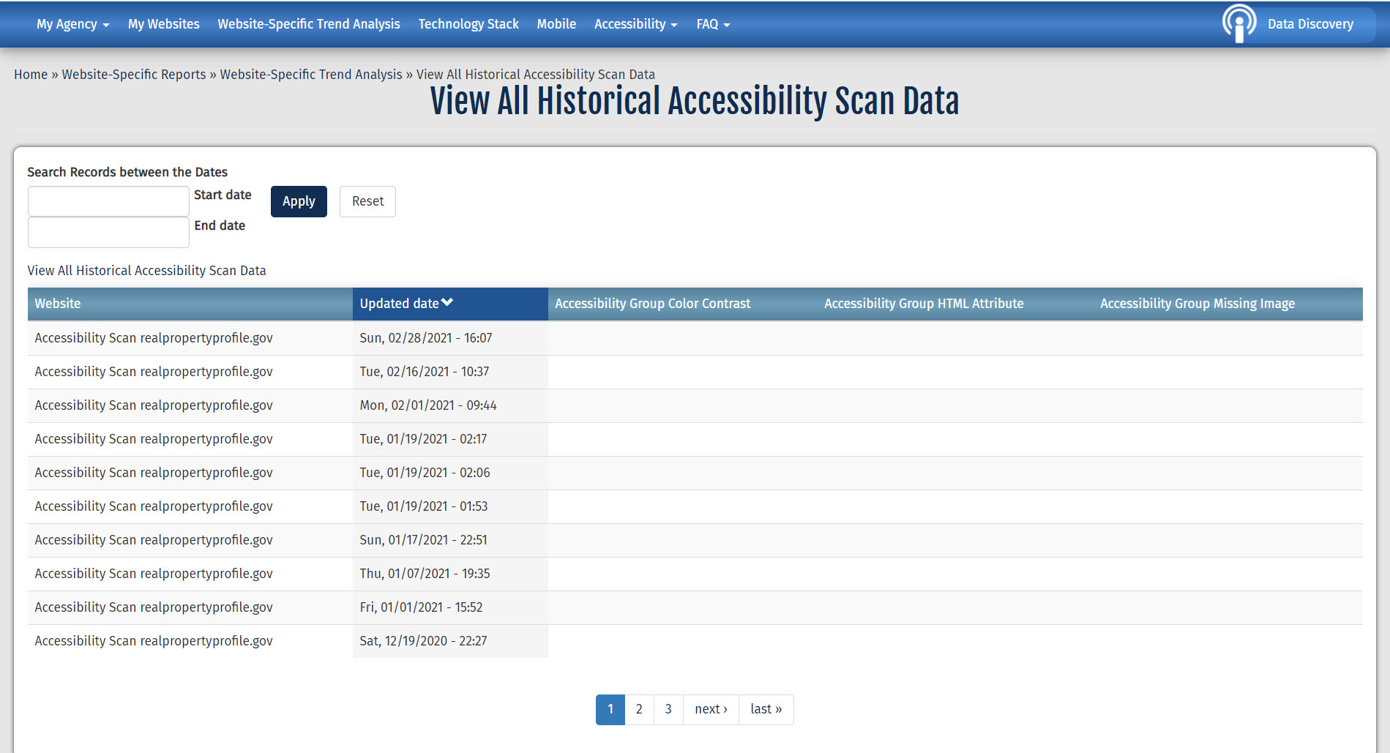
Historical Accessibility Data
Notes:
SPEAKER: You can also find historical scan results in the Accessibility Module by selecting it from the Accessibility Menu.

Slide 38
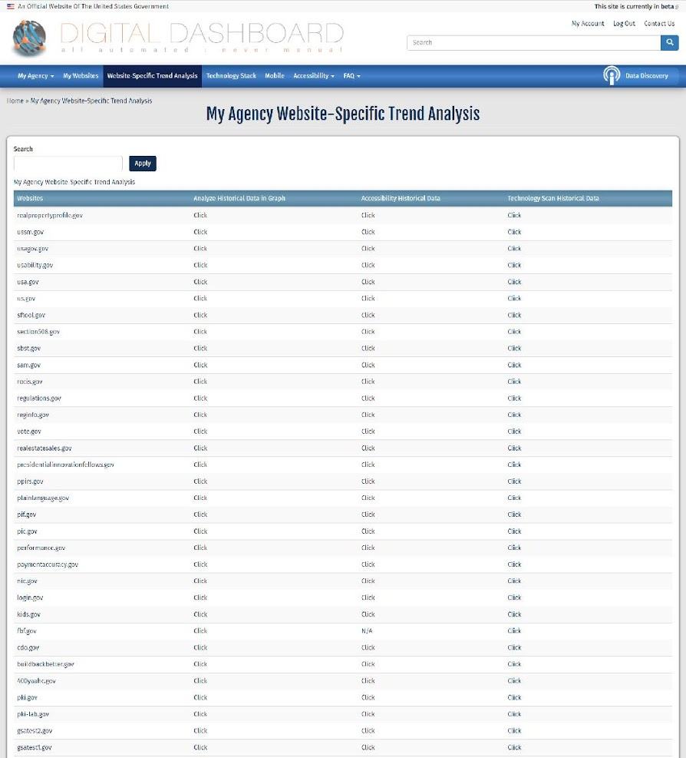
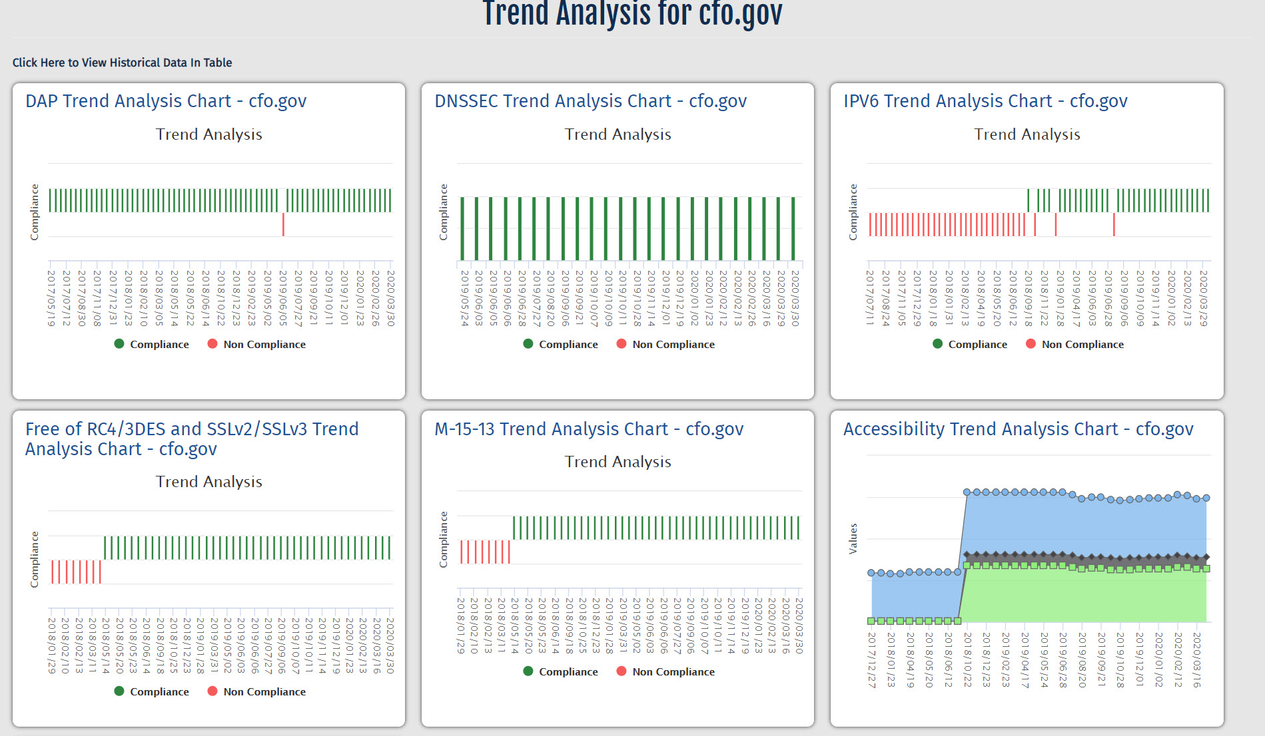
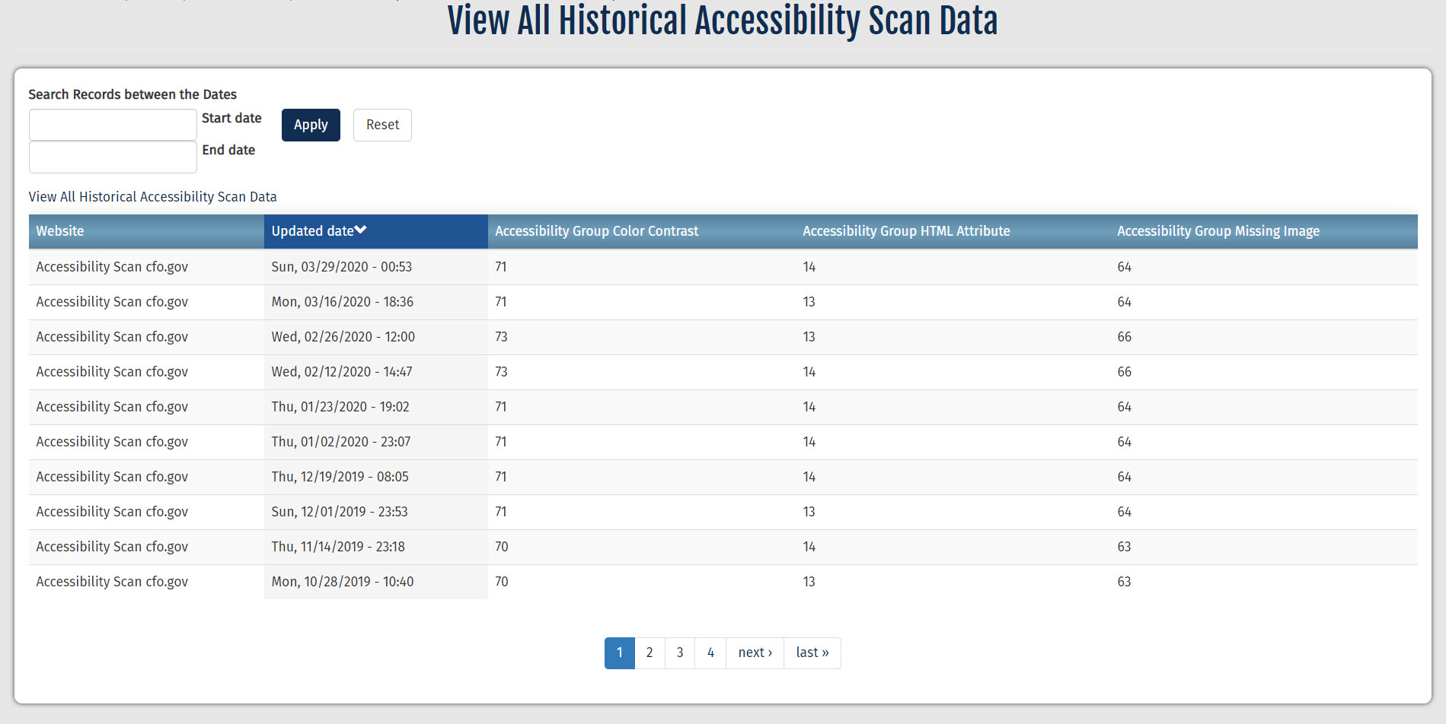
Trend Analysis
Notes:
SPEAKER: The Website-Specific Trend Analysis tab allows you to access historical information by website so you can analyze your website’s performance over time. You can select to view this information in graph or table format.

Slide 39
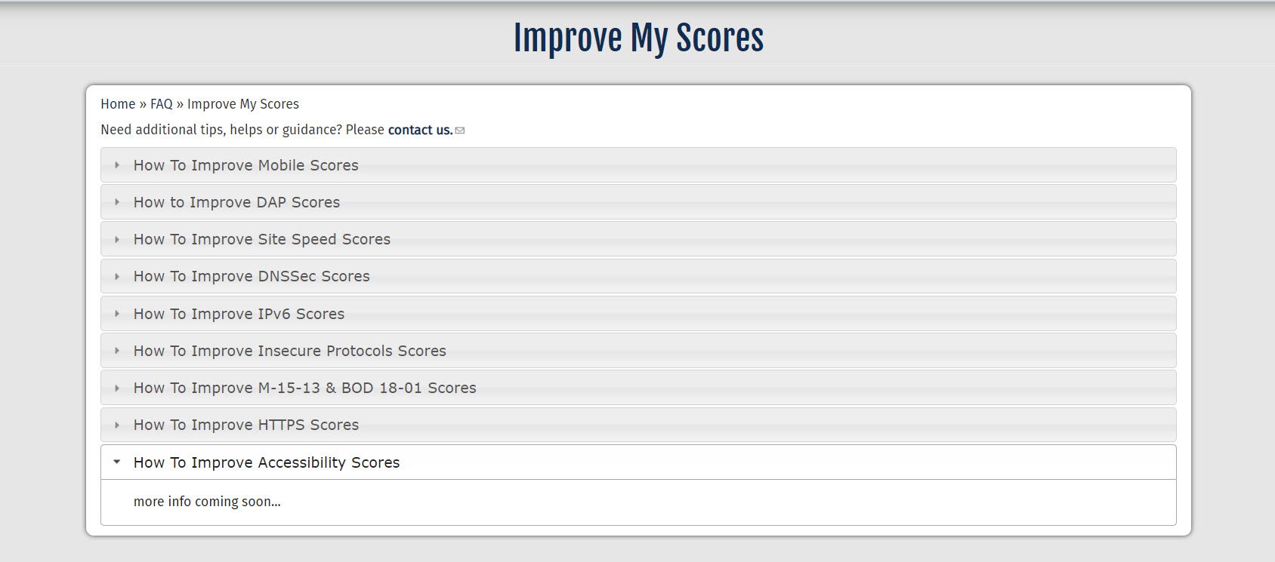
Improve My Scores
Notes:
SPEAKER: The Digital Dashboard FAQ menu includes a page with tips to improve scores for each of the categories analyzed by the Digital Dashboard. While the tips for the Accessibility Module are currently in development, they should be available in the near future. Check back soon for more information.

Slide 40
QUESTION: How many issues does your agency have? Which type of issue is the most common?
Notes:
INSTRUCTIONS: Before we close, let’s take a minute to log in. Anyone who currently has a Max account, go ahead and log into the Accessibility Module, then I will ask a couple of questions.
First, the report for your agency. How many total issues did the most recent scan find? Post your answer in the Chat pod.
Which type of issue is the most common for your agency? Post your answer in the Chat pod.
You are encouraged to continue to explore the Accessibility Module after we conclude and refer to it periodically to check your agency’s performance.

Slide 41

Webinar Wrap-up
Closing Remarks
Thank you for coming!
Remember – accessibility is everyone’s responsibility.
Email dotgovdashboard@gsa.gov for help with answering any questions that might arise while using the Accessbility Module or see Section508.gsa.gov.
Notes:
INSTRUCTIONS: Thank participants for attending the webinar, wish them well in applying all they have learned to their work duties, and remind them to email dotgovdashboard@gsa.gov for help with answering any questions that might arise while using the tool or see the resources on Section508.gsa.gov.

